Slide 1
Promilo Assignment
Data Analysis and Insights for different page Optimization & How to get more user install & Engagement from the App & Website

Slide 2
Data Exploration
Key Variables Avaliable for analysis :
New users - New unique users landing on app website through different channels
Users - Existing users
Engagement rate - Engagement rate is a measure of how much of your audience actively engages with your contents.
Engaged sessions per user- Engaged sessions per User is the summation of the total number of sessions per user averaged by the total user count.
Engaged sessions- A session is a period during which a user is engaged with your website or app. An engaged session is a session that lasts longer than 10 seconds, has a conversion event, or has at least 2 page views or screen views.
Average engagement time- “Average Engagement Time per Session” as User engagement duration per session. “User Engagement” as the length of time that your app screen was in the foreground or your web page was in focus.
Event count, Town/City, User_Percentage, Gender, Event name etc.

Slide 3
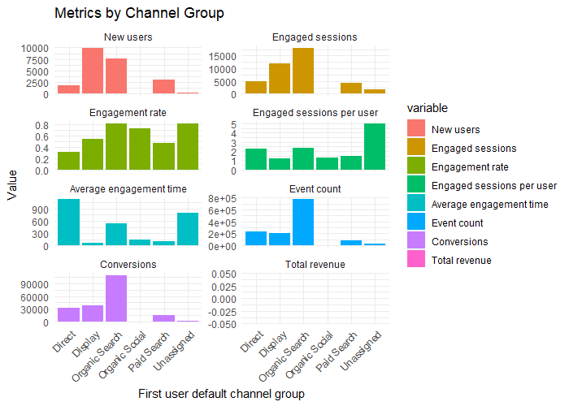
New user acquisition
To draw new users we must improve quality and offer better discounts on Display channel and Organic search channel .
Similarly we can pull a lot of users from direct search channel because average engagement time from direct channel is quite higher
Need to work hard during admission period i,e May to Sept because it peak time of bussiness and pull conversions.
Some ways to improve Organic Search are :
1. Keyword Research
2. Content Optimization
3. On page SEO
4. Page speed Optimization
5. Social Signals
6. User Experience (UX)
7. Technical SEO

Slide 4
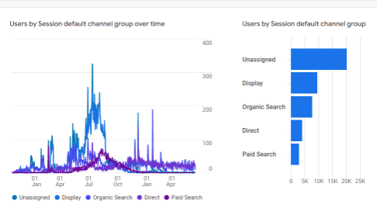
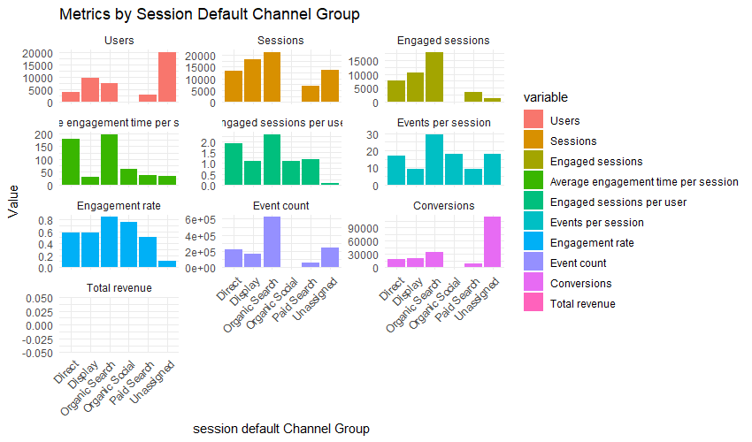
Traffic Aquisition
According to the data we can see that there are more Unassigned channels which leads to mislead Analysis of traffic of our app. We need to fix it ASAP
It is clear that no.of sessions , average engagement rate , average engagement time are higher in Direct channel , Display channel and Organics search channel we must prioritize it .
Next form the time Series Chart we can make user that our app is in max usage during the month of May to July(Since it is an end academic . So we can take some efforts to advertise(Campaigns) our app via various Study related websites like W3 Schools, Javatpoint, Tutorials Point, Hacker Rank, Hacker Earth, Byju`s etc. and Social Media like Instagram, Facebook Messenger, Threads etc. So that we can increase More users.
Some ways to reduce Unassigned channel Traffic are Review Default Channel Grouping, Implement UTM Parameters, Use Google Tag Manager, Check Campaign Tagging Accuracy, Cross-Domain Tracking, Analyze Landing Pages etc,
We need to hire more Sales and Academic Counsellors to contact each users through cold calls, text , email, and social media platform with impacting sales pitching to get more conversions and revenue.

Slide 5
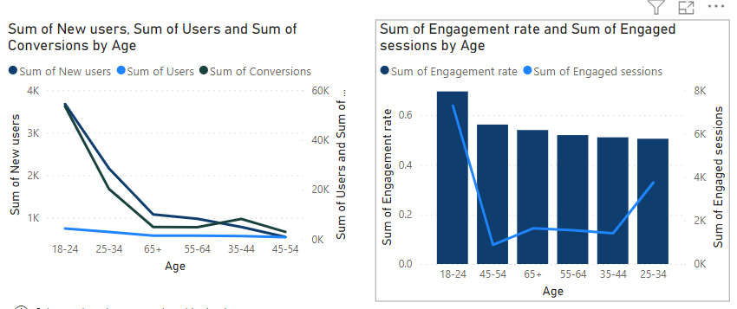
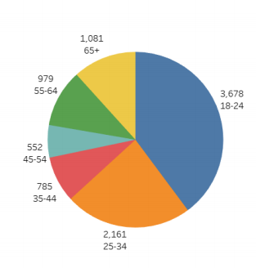
User BY age
New users vs Age group
In the view of Customers age, people in the age category between 18-24 are more users who are in the category of students , Job seekers.
New users, Engagement rate, Engaged session,Conversiona there are more New users in this age category who reach our App are more.

Slide 6
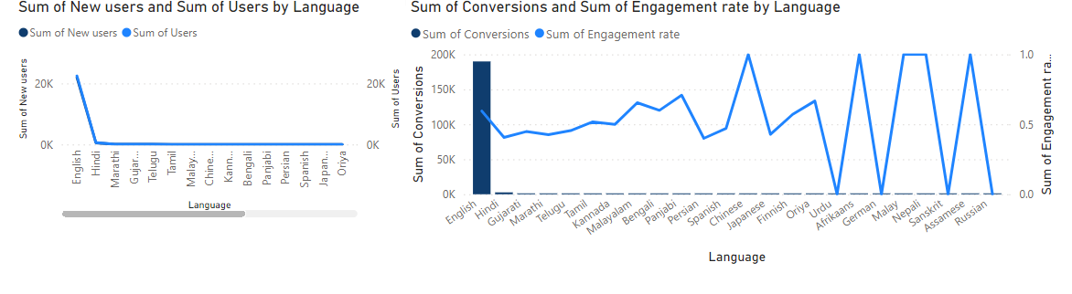
User BY Language
From Users Language preference we can infer that there are more New and Existing users use English as a major language for usage we can improve its efficiency we can reach more users.
Other than English Hindi,Tamil,Chinese,Nepal,Assame,Malayalam languages have high engagement rate if we improve those languages too will help us to reach more new user form these Areas

Slide 7
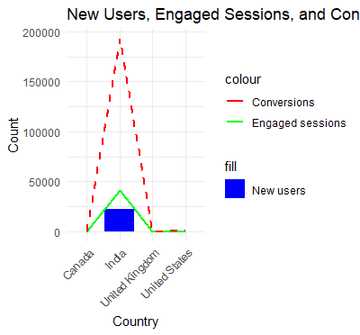
DEMOGRAPHICS
From Demographics data’s we can see that More New users, Existing Users, Engagement rate ,Conversion are in India whom uses our app.
Next to India,United States,Canada ,Uk and Singapore are some prominent users who shows some interest in using our services so we can improve our services in that country to take the business internationaly.
We can seek international collaboration or investment in overseas to advertise our product.
Offshore hiring is the key .

Slide 8
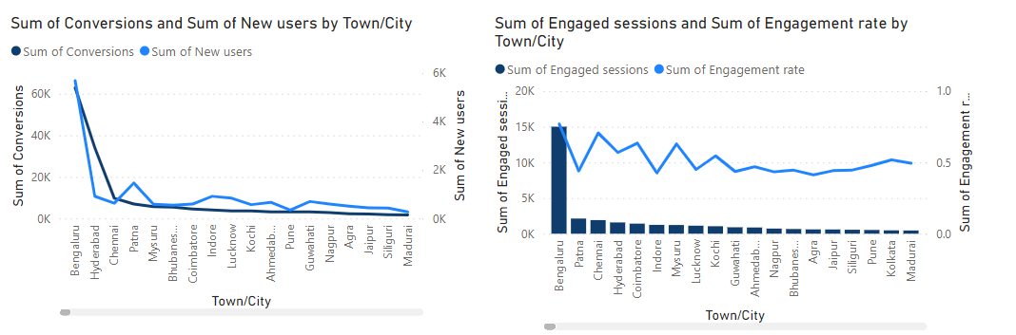
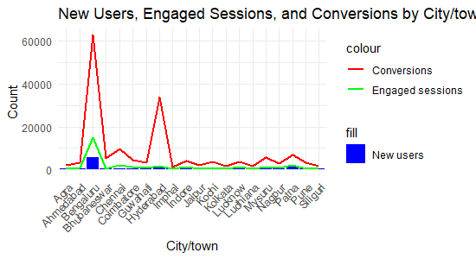
city/ townwise analysis
From cite wise(Town/city) data we can see the More New users reach our app are from Bengaluru,Hydreabad,Chennai where are more IT companies and colleges are located so we can made Advertisements in these areas we can reach more customers to our app.
In addition to that some of the areas in central states also have more Engagement rate if we made campaign is those areas also really helpful to improve the Users count .

Slide 9
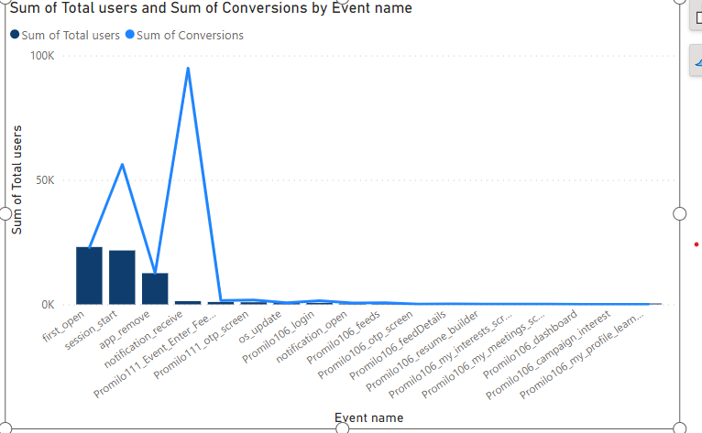
CONVERSION REPORT
From conversion report we can see that maximum users are interested in opening the app for first time which is seen as first-open event ,with that we can say that more New users are trying to use our app
In view of conversions the event notification-receive have maximum conversion so we can use this area to deliver more services to the users like notifying the user about new job opportunities, About the informations about college events like admissions, Internships, Entrance Exams with which user can spend more time in our app based on the information we provide.
We can see that events like promilo-login, feeds, dashboard, resume builder have very less conversions so we have to improve the styles,designs of pages to attract users and improve user experience to increase conversions in these events

Slide 10
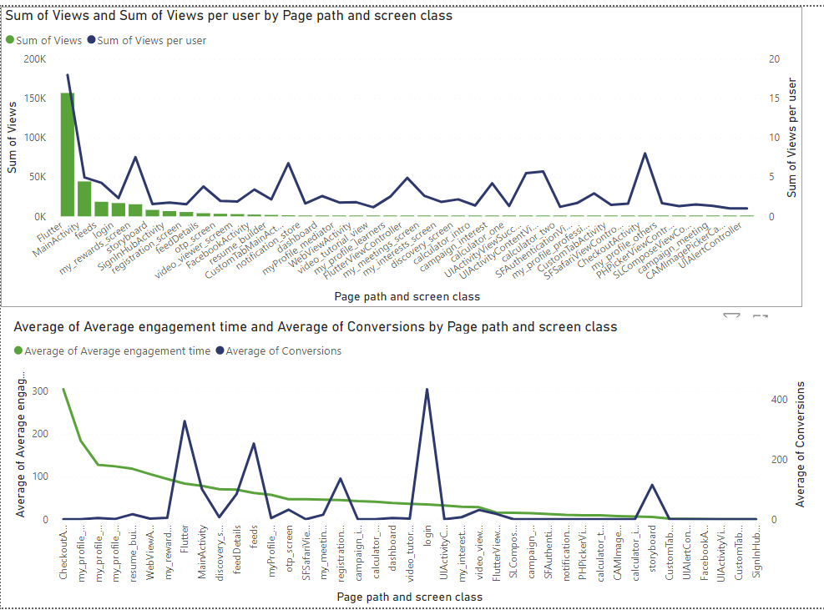
SCREENS AND PAGES REPORT
From Screens and Pages Report we can see that in the terms of Views the total views and views per user are high in flutter Page screen.In terms of single user the views are also more in areas like Login,My Screen Rewards,UIActivity and checkout Activity.
In other pages the views are low so we have to improve the quality and UI in that pages to engage users and spent time on the main screens of the app .
In terms of conversions Many users makes an attempt to login to the app and also spend saw our feeds page,story board and registration page which are some main pages of the app.If we make an attempt to improve all pages like this we can even attract more users to install our app.If we increase UX designs in this pages like dashboards,feed pages we can also increase the engage time of the users

Slide 11
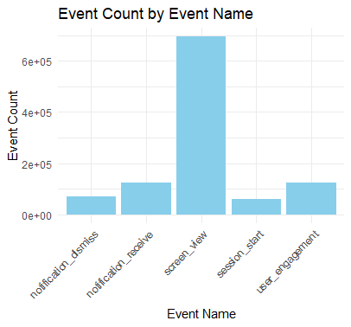
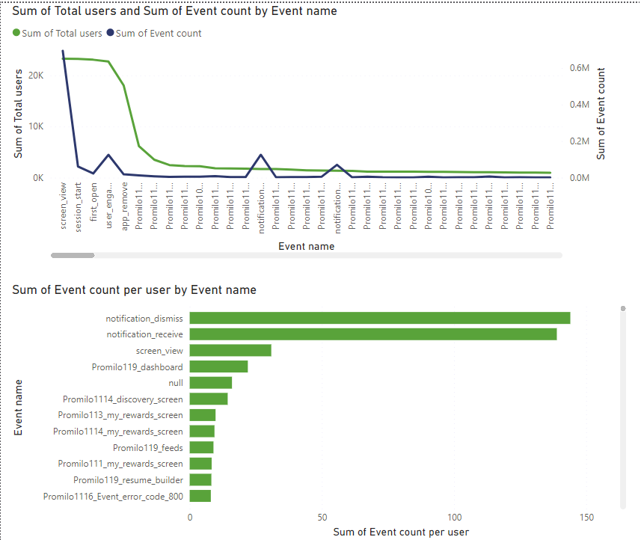
EVENT REPOrT
From the Event Report, with features like event name, event count ,Total Users, Event count per user we can infer that screen_view ,notification receive,notification dismiss events are done by more users and other than that we have to make improvement on others too.
We can raise the bar by making out notification popout more funny , more trendy more humourous and more genuine
We must avoid send unnecessary pop ups which may lead to unistallations, send greetings and special offers will turn up more views and conversions

Slide 12
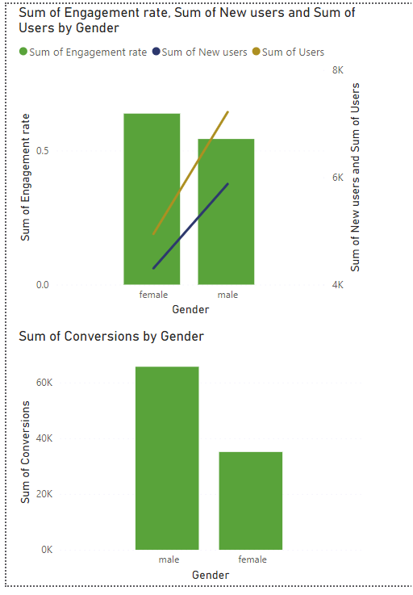
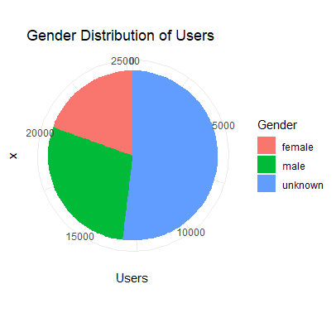
GENDER REPORT
In the view of gender New users, Existing users, Conversions are more in Male category than female.
But Female users use the app more time than Male.
So we can make an effort to attract more Female Users via some webistes through which we can reach them more like pets website, beauty products related website like diplay ads,beauty pages in Instagram site etc.
1. Most of the new users and old users are male female constitute upto
42.27% and Males 57.73% in the old users.
2. Engagement Rate of females are higher than male while conversions
are more in male.

Slide 13
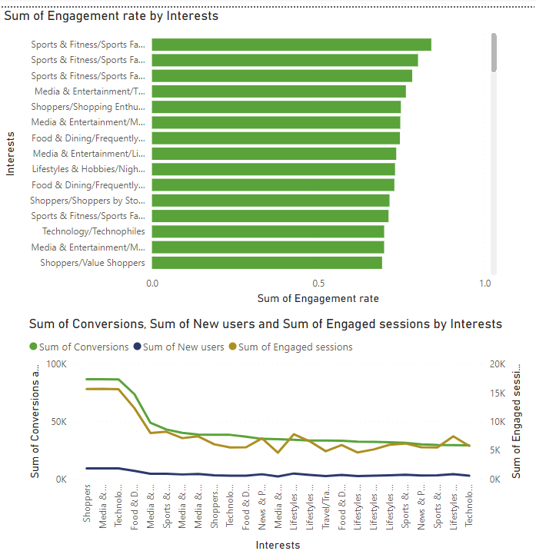
BY INTERESTs
From the Interest data we can see that New users who visit the app are interested in searching for shopping ,Media and Entertainment, Technology and Mobile Enthusiasts.
But In the view of engagement rate sports and fitness ranks first that more users spend time more on sports related information so we can improve and give more details related to sports ,Media,Technology,Food related concepts to attract more users.

Slide 14
strategic plan
Customer Segmentation and Personalization:
Target Specific Age Groups: Concentrate marketing efforts on the 18-24 and 25-34 age ranges, as they constitute the majority of users. Create tailored campaigns that highlight how the app addresses their unique interests and needs.
Engagement-Based Segmentation: Segment users by engagement patterns. Focus on re-engaging middle-aged users and maximizing the value derived from the high-engagement 65+ age group.
Gender-Based Marketing: Leverage Female Engagement: Given the higher engagement rate among females, create content and features that resonate with them. Highlight female-friendly aspects of the app in marketing materials.
Channel Optimization: Organic Search Enhancement: Capitalize on the high engagement rate from organic search channels. Optimize content and landing pages for improved conversion rates and better user experience.
Direct Channel Maximization: While the direct channel has fewer users, their higher engagement and profitability make them valuable. Implement strategies to attract more users through this channel while maintaining high-quality engagement.
Enhancing Engagement: Improving Engagement Time: Focus on increasing the average engagement time across all channels. Offer more interactive content, personalized recommendations, and features that hold users' attention longer.

Slide 15
Targeting High-Potential Channels: For channels with moderate to high engagement rates but low average engagement time, experiment with content variations and user
journeys to increase time spent within the app.
Conversion Optimization: Conversion Optimization for Males: Given that conversionsare higher among males, analyze the user journey and optimize it to streamline the
conversion process. Implement A/B testing to identify the most effective conversionstrategies.
Conversion Strategies for Females: While females exhibit higher engagement rates, ensure that the conversion process is equally smooth for them. Address any potential pain points and offer incentives to drive conversions.By focusing on these strategic areas, you can leverage the strengths of each user segment, optimize engagement and conversion rates, and enhance the overall user experience.Regularly monitor user behavior and feedback to make iterative improvements and refineyour strategies accordingly

Slide 16
Expected Benefits:
Targeted Age Groups: Focusing on 18-24 and 25-34 segments maximizes engagement among the majority, leading to higher downloads and usage.
65+ Engagement: Tailoring features for the growing 65+ demographic enhances loyalty and potentially increases long-term app value. Female-Centric Approach: Crafting campaigns for females leverages higher engagement, driving more downloads and interaction.
Channel Optimization: Improving organic search content and maximizing direct channel engagement elevates conversions and profitability.

Slide 17
Summary
This report provides data-driven insights and strategic recommendations to optimize app downloads and engagement across different user segments. The analysis is based on user demographics, engagement rates, and conversion patterns. By aligning strategies with user behavior, the goal is to enhance user satisfaction andoverall app success.
Segmentation for Targeted Impact:
Focus efforts on the 18-24 and 25-34 age groups, which form the majority of new
and active users. Craft personalized campaigns to resonate with their interests,
driving higher downloads and interaction. Additionally, capitalize on the growing user
base of individuals aged 65+, tailoring features to meet their preferences for
increased engagement and loyalty.
Gender-Centric Approach:
Leverage the higher engagement rate among females by creating content that appeals to their interests. This approach can lead to increased downloads, morerobust engagement, and potentially higher conversion rates.

Slide 18
Strategic Channel Optimization:
Enhance organic search content to improve engagement and conversions,addressing user intent for longer engagement periods. Maximize the direct channel,characterized by high engagement and profitability, to ensure sustainable revenue growth through quality interactions.
Elevating Engagement Experience:
Implement interactive content, personalization, and gamification elements to extend user engagement, especially for younger and older age groups. This extendedengagement opens up more opportunities for conversions and in-app activities.
Effective Conversion Enhancement:
Streamline conversion journeys for both males and females to capitalize on their higher conversion rates. Optimized journeys lead to more successful conversions , ultimately driving higher app usage and potential revenue growth.
By implementing these data-backed strategies The app can tap into its user demographics' preferences, optimize engagement rates, and enhance the overall user experience. Regular monitoring, adjustments, and iterative improvements based on ongoing data analysis will be key to achieving sustained growth in downloads, engagement, and overall app success.

